Slide 1
Shapley Values
Game Theory to Computational Physics

Slide 2

SHapley Additive exPlanations (SHAP)
Introduced by Lloyd Shapley in 1951
Accepted method for distributing gains in coalitional game theory
In other words, Shapley values represent the expected marginal contribution of a player, feature, or variable.
Particularly useful for Game Theory and Machine Learning.

Slide 3
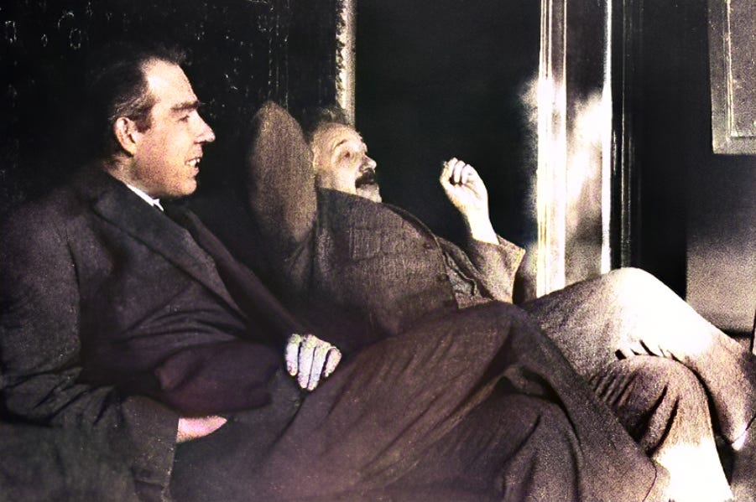
Example: Splitting the Check, Not the Atom
Albert Einstein and Niels Bohr go out to dinner.
Al thought his companion was a bit of a…Bohr, so he munched to keep himself entertained.
The check comes back at $60. Al suggests that they each pay $30.
Enraged, Bohr claims he didn’t eat $30 worth of food. The two physicists decide to time travel to 1951 to find a fair solution.
Enter Shapley values…

Slide 4
Example: Splitting the Check, Not the Atom
Consider the following contributions:
C_{AB} = 60
C_{A} = 30
C_{B} = 25
C₀ = 0
Find value of C_{A}:
C_{AB} - C_{B} = 35
C_{A} – C₀ = 30
S_{A} = (35+30)/2 = 32.5
Find value of C_{B}:
C_{AB} - C_{A} = 30
C_{B} – C₀ = 25
S_{B} = (30+25)/2 = 27.5
Solution:
Einstein should pay $32.50, and Bohr should pay $27.50.

Slide 5
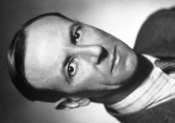
Example: Splitting the Check, Not the Atom (part 2)
Albert Einstein and Niels Bohr are joined at dinner by their good friend James Chadwick. The check comes back at $80.
Excited to share their futuristic method, Al and Bohr suggest to Chadwick that they use Shapley values to calculate each diner’s portion of the check.
Consider the following coalitions:
C_{ABC} = 95
C_{AB} = 60, C_{AC} = 70, C_{BC} = 65
C_{A} = 30, C_{B} = 25, C_{C} = 40
C₀ = 0

Slide 6
Example: Splitting the Check, Not the Atom (part 2)
Find value of C_{A}:
C_{ABC} - C_{BC} = 30
C_{AB} – C_{B} = 35
C_{AC} – C_{C} = 30
C_{A} – C₀ = 30
S_{A} = (35+35+30+30)/4 = 31.25
Find value of C_{B}:
C_{ABC} - C_{AC} = 25
C_{AB} – C_{A} = 30
C_{BC} – C_{C} = 25
C_{B} – C₀ = 25
S_{B} = (25+30+25+25)/4 = 26.25
Find value of C_{C}:
C_{ABC} - C_{AB}= 30
C_{AC} – C_{A} = 40
C_{BC} – C_{B} = 40
C_{C} – C₀ = 40
S_{C} = (20+40+40+40)/4 = 37.50
Solution:
Einstein pays $31.25, Bohr pays $26.25, and Chadwick pays $37.50.

Slide 7
Let’s revisit the formula for Shapley values:
N! = number of ways to form a coalition
|S| = number of players in coalition S
|S!| = number of ways coalition S can form
(|N| - |S| - 1)! = number of ways players can join after player 1
(v(S ∪ {i})) = gains of coalition including player i
V(S) = gains of coalition without player i
Basically comes down to a messy weighted average.

Slide 8
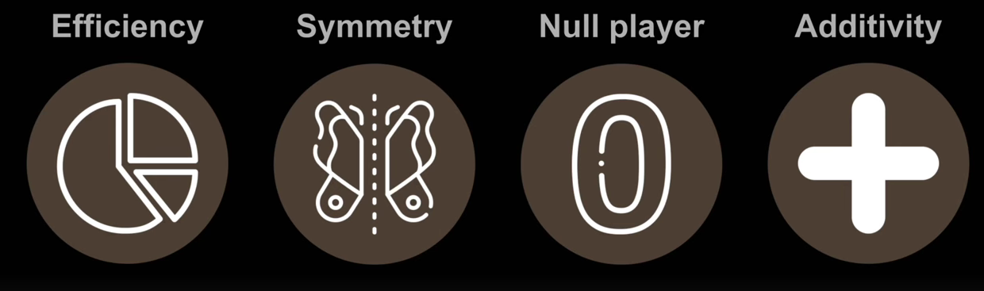
Axioms of Shapley Values
Efficiency: Marginal contributions sum to the whole
Symmetry: Players are considered interchangeable if they make the same contributions
Null Player: Zero value is awarded if a player contributes zero value.
(Like Einstein, if the dinner was held at a steakhouse)
Additivity: Combined contributions from two games are the sum of the contributions from each of the two games; in other words, games are independent.

Slide 9

Drawbacks of Shapley Values
While Shapley values drastically increase the speed at which we can make predictions in Machine Learning, it is extremely computationally expensive.
What do we do when things are expensive? We approximate!
Monte Carlo sampling
This is still fairly impractical, as we need a very large sample size, so mainly we can resort to Shapley packages in Python!
KernelSHAP, or TreeSHAP (can only be used with tree-based algorithms)

Slide 10
Applications of Shapley Values
Coalition Game Theory
Shared spoils for victory, shared credit for grades on a group project, etc.
Machine Learning:
Contribution of different features to a model’s prediction.
Sports: impact of different players on a score
Do offensive lineman deserve partial credit for a rushing TD?
Biomechanics:
Contribution of different joint movement patterns to an overall objective
Physical Systems:
Oscillating System Analysis, Quantum State Classification, Nuclear Binding Energy

Slide 11
Shapley Values in RK4
Compare the impact of each k_{i} on the overall slope modelled in a fourth-order Runge-Kutta simulation.

Slide 12
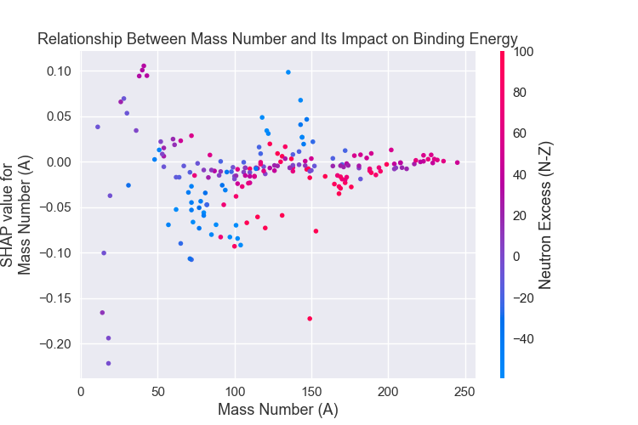
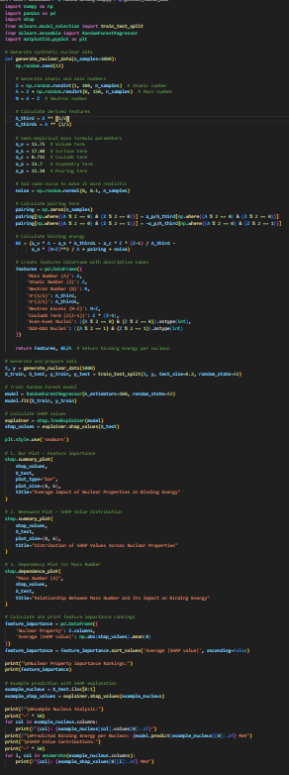
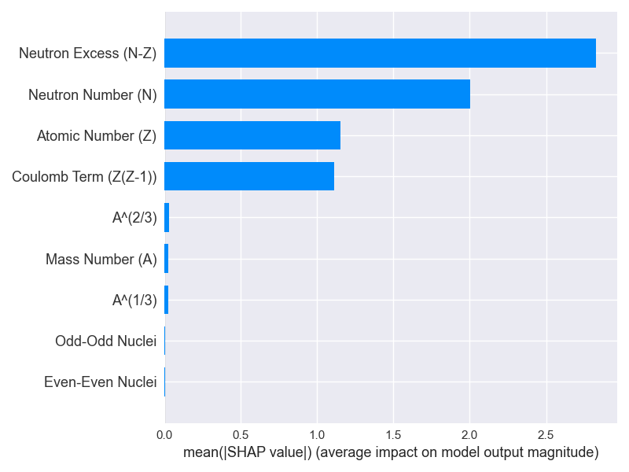
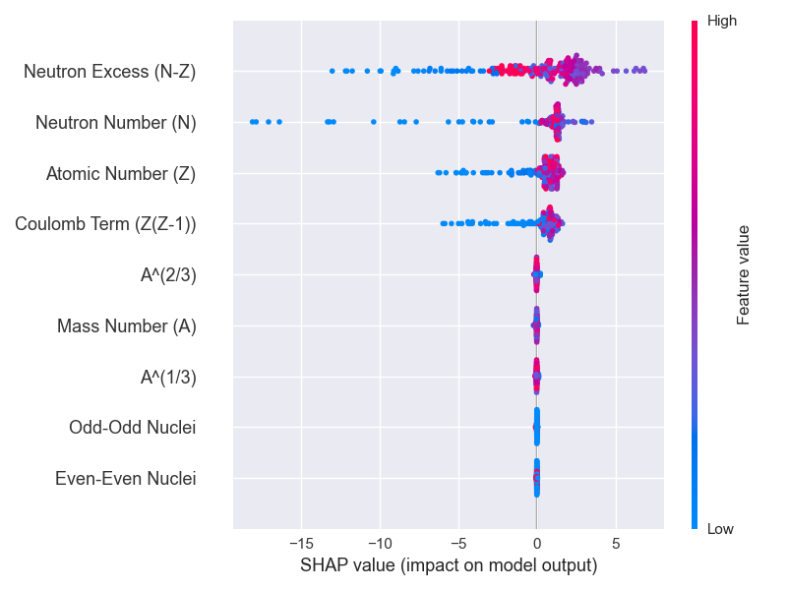
Nuclear Binding Energy: Using shap library in Python
Dependency Plot showing relationship between two variables
Comparing SHAP magnitude for different variables
Beeswarm Plot showing effect of SHAP values on predictions

Slide 13
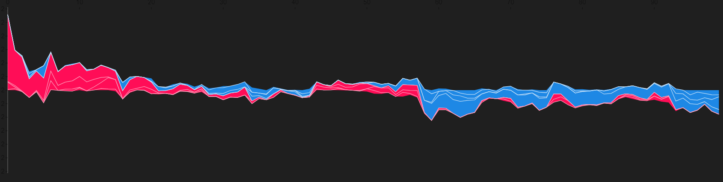
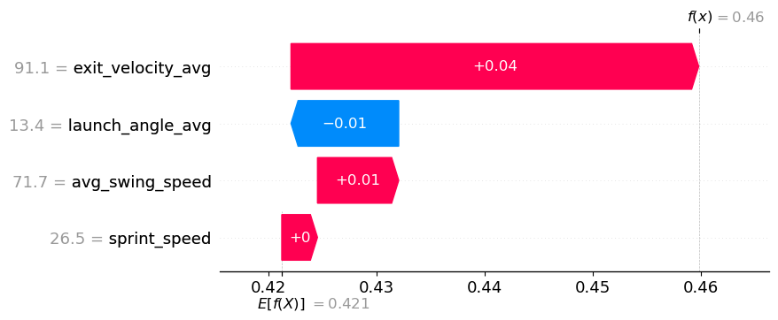
Statistical Modelling Example
Baseball Statistics Example
Interactive Stacked Force Plot
Waterfall Plot

